Slide 1
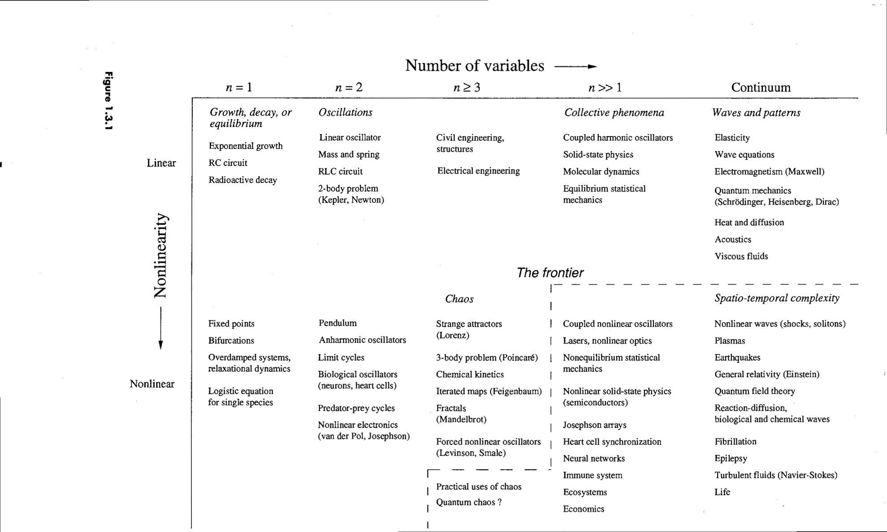
Nonlinear Dynamics
Bifurcation theory , Fixed points, Limit Cycle and Chaos

Slide 2
Bifurcation in 1-d systems
Eigenvalues 2-d linear systems
Romeo vs Juliet
Stability of fixed points: Jacobian analysis
Rabbit vs Sheep
Predator –prey interaction
Limit cycles
Synchronization of limit cycles: Kuramoto oscillators

Slide 3

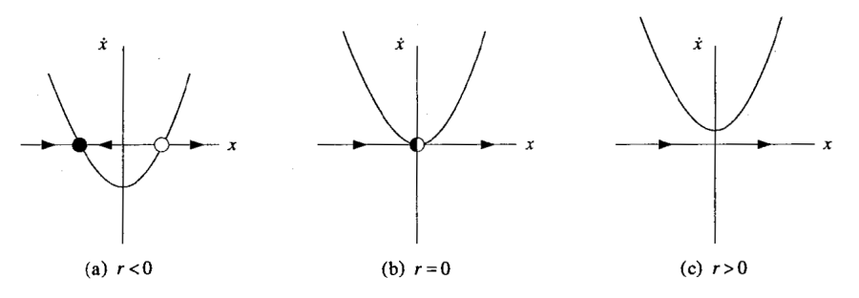


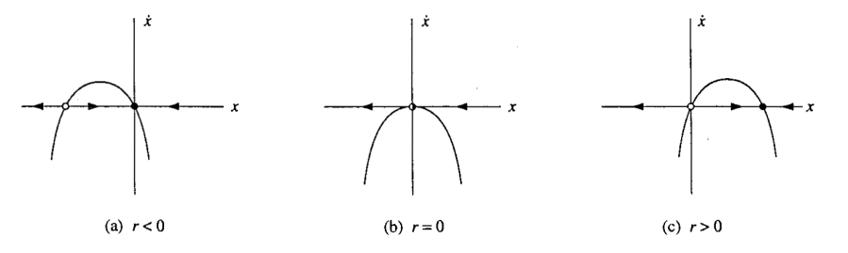


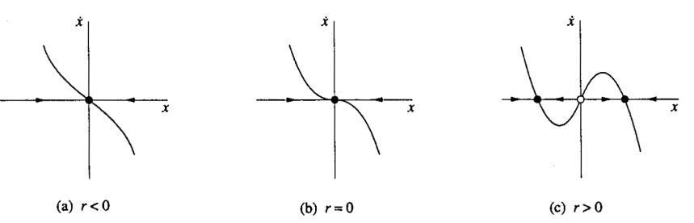

Nonlinear Dynamics
Bifurcation theory , Fixed points, Limit Cycle and Chaos
1-D Flow Three types of Bifurcation
2-D Flow: Birth of Limit Cycle
3-D Flow: Chaotic Oscillation

Slide 4

Classification of linear systems

Slide 5

Classification of linear systems
$$x\left(t\right)=e^{λt}v$$

Slide 6

Classification of linear systems
$$x\left(t\right)=e^{λt}v$$

Slide 7

Classification of linear systems
$$x\left(t\right)=e^{λt}v$$

Slide 8
Classification of linear systems
$$x\left(t\right)=e^{λt}v$$

Slide 9
Solving Initial Value Problem (Model 7)

Slide 10
Solving Initial Value Problem

Slide 11
Solving Initial Value Problem

Slide 12
Solving Initial Value Problem

Slide 13
Love Affairs (Model 8)

Slide 14
Love Affairs

Slide 15
Love Affairs
Never ending cycles of love and hate
Governing system has center at (0,0)
They manage love simultaneously one quarter of time

Slide 16
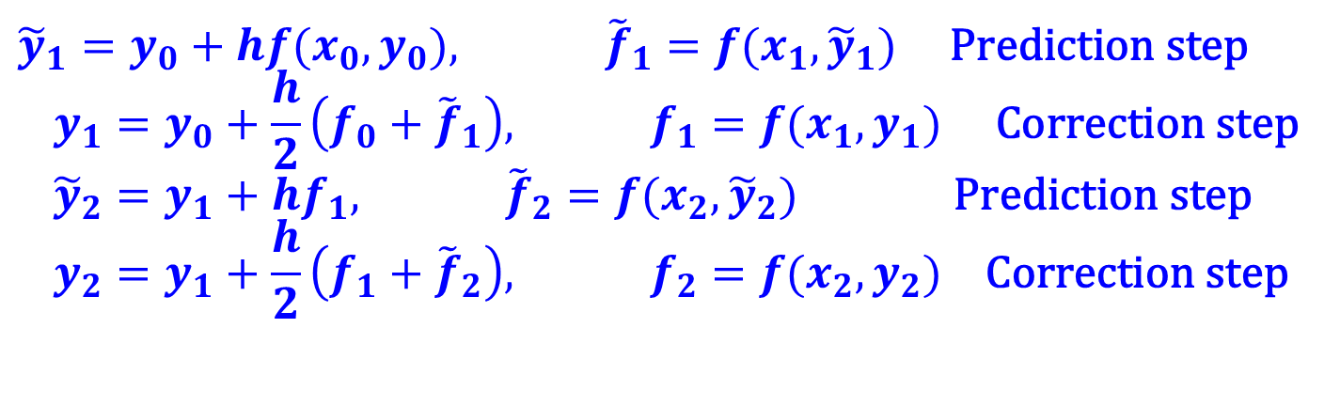
Improved Euler Method
Similar in concept to the trapezoid rule in quadrature, by utilizing an average of the start and end point derivatives we can better approximate the change in y over the interval
This is the simplest example of so called “Predictor-Corrector” methods, (which includes Runge-Kutta methods)
$${\tilde{y}}_{1}=y_{0}+hf(x_{0},y_{0}), {\tilde{f}}_{1}=f(x_{1},{\tilde{y}}_{1}) \text{Prediction} \text{step} \\ y_{1}=y_{0}+\frac{h}{2}\left(f_{0}+{\tilde{f}}_{1}\right), f_{1}=f(x_{1},y_{1}) \text{Correction} \text{step} \\ {\tilde{y}}_{2}=y_{1}+hf_{1}, {\tilde{f}}_{2}=f(x_{2},{\tilde{y}}_{2}) \text{Prediction} \text{step} \\ y_{2}=y_{1}+\frac{h}{2}\left(f_{1}+{\tilde{f}}_{2}\right), f_{2}=f(x_{2},y_{2}) \text{Correction} \text{step}$$

Slide 17


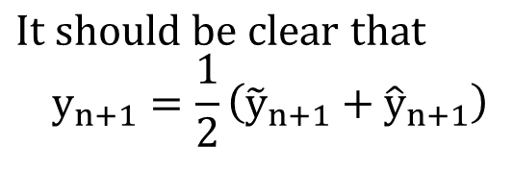
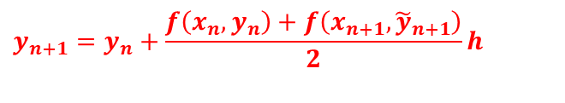

Improved Euler method graphically
y(x)
$${\tilde{y}}_{n+1}=y_{n}+hf(x_{n},y_{n})$$
$$y_{n+1}=y_{n}+\frac{f\left(x_{n},y_{n}\right)+f\left(x_{n+1},{\tilde{y}}_{n+1}\right)}{2}h$$
y_{n}
$${\hat{y}}_{n+1}=y_{n}+f(x_{n+1},{\tilde{y}}_{n+1})h$$
$$\text{It} \text{should} \text{be} \text{clear} \text{that} \\ y_{n+1}=\frac{1}{2}\left({\tilde{y}}_{n+1}+{\hat{y}}_{n+1}\right)$$
x_{n} x_{n+1}
Can show that errors in this method are also
$$e_{i}∝O(h^{3}) {\text{E}}_{n}∝O(h^{2})$$

Slide 18
Example : Rabbit Vs Sheep, Lotka-Volterra, SIR dynamics

Slide 19
Jacobian analysis

Slide 20
Jacobian analysis

Slide 21
Jacobian analysis

Slide 22
Jacobian analysis

Slide 23
Rabbit Vs Sheep
Classic Lotka-Volterra model
Note :
Each species would grow to its carrying capacaity in absence of the other.
( Recall Logistic growth equations : one self linear and the other negative nonlinear terms)
Both eat grass.
Rabbits have legendary ability to reproduce : thus higher intrinsic growth rate.
Sheep usually beat rabbits when fighting for same tuft of grass.

Slide 24
Rabbit Vs Sheep
Classic Lotka-Volterra model
Note :
Each species would grow to its carrying capacaity in absence of the other.
( Recall Logistic growth equations : one self linear and the negative nonlinear terms.)
Both eat grass.
Rabbits have legendary ability to reproduce : thus higher intrinsic growth rate
Sheep usually beat rabbits when fighting for same tuft of grass.

Slide 25
Rabbit Vs Sheep
Classic Lotka-Volterra model

Slide 26
Rabbit Vs Sheep
Classic Lotka-Volterra model
Fast reproduction. Higher carrying capacity. Sheep threaten them.
Slower reproduction. Lower carrying capacity. Rabbits threaten less.

Slide 27
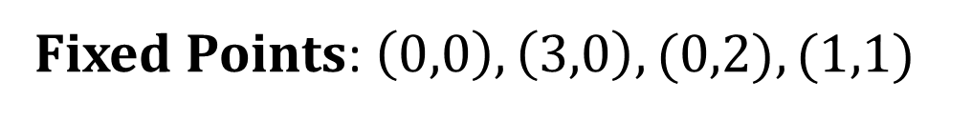
Rabbit Vs Sheep
Classic Lotka-Volterra model
Fixed Points: $\left(0,0\right), \left(3,0\right), (0,2), (1,1)$

Slide 28
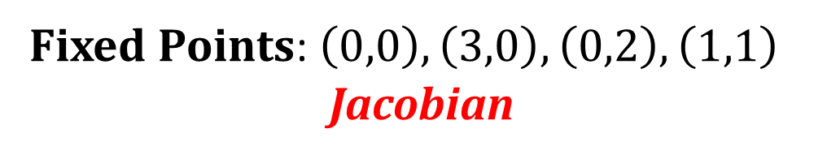
Rabbit Vs Sheep
Classic Lotka-Volterra model
Fixed Points: $\left(0,0\right), \left(3,0\right), \left(0,2\right), \left(1,1\right)$
Jacobian

Slide 29
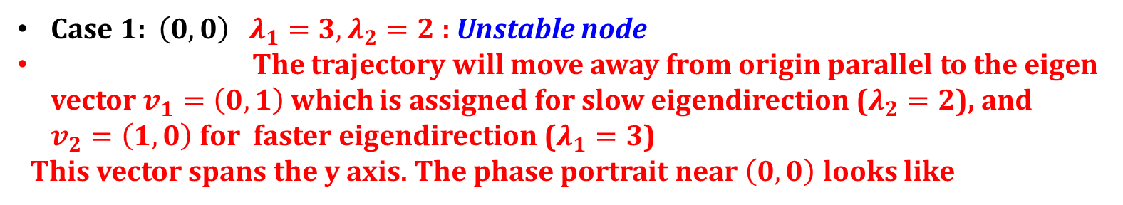

Rabbit Vs Sheep
Classic Lotka-Volterra model
Fixed Points: $\left(0,0\right), \left(3,0\right), \left(0,2\right), \left(1,1\right)$
Jacobian
Case 1: $\left(0,0\right)$ $λ_{1}=3, λ_{2}=2$ : Unstable node
The trajectory will move away from origin parallel to the eigen vector $v_{1}=\left(0,1\right)$ which is assigned for slow eigendirection ($λ_{2}=2$), and $v_{2}=\left(1,0\right)$for faster eigendirection ($λ_{1}=3$)
This vector spans the y axis. The phase portrait near $\left(0,0\right)$ looks like

Slide 30

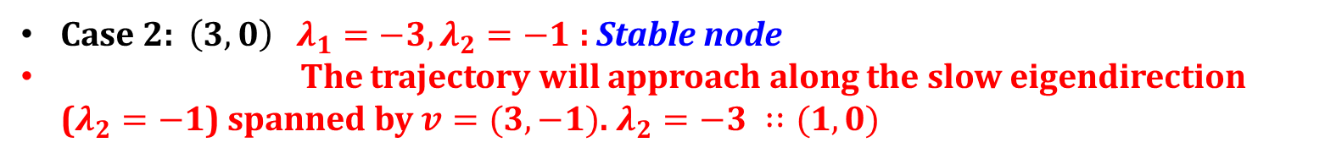

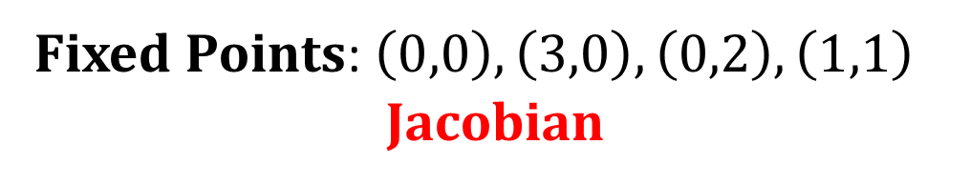

Rabbit Vs Sheep
Fixed Points: $\left(0,0\right), \left(3,0\right), \left(0,2\right), \left(1,1\right)$
Jacobian
Case 1: $\left(0,0\right)$ $λ_{1}=3, λ_{2}=2$ : Unstable node
The trajectory will move away from origin parallel to the eigen vector $v_{1}=\left(0,1\right)$ which is assigned for slow eigendirection ($λ_{2}=2$), and $v_{2}=\left(1,0\right)$for faster eigendirection ($λ_{1}=3,$)
This vector spans the y axis. The phase portrait near $\left(0,0\right)$ looks like
Case 2: $\left(3,0\right)$ $λ_{1}=−3, λ_{2}=−1$ : Stable node
The trajectory will approach along the slow eigendirection ($λ_{2}=−1$) spanned by $v=(3, −1)$. $λ_{2}=−3 ∷(1,0)$
$$\left(\begin{matrix}−3 & −6 \\ 0 & −1\end{matrix}\right)$$

Slide 31
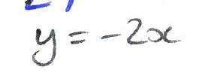
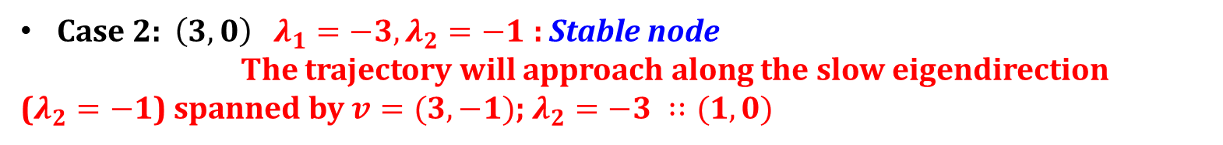

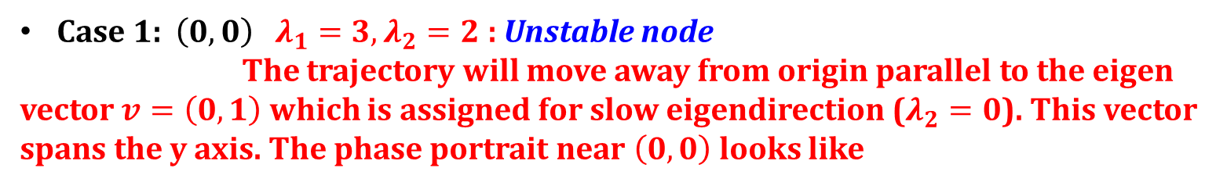
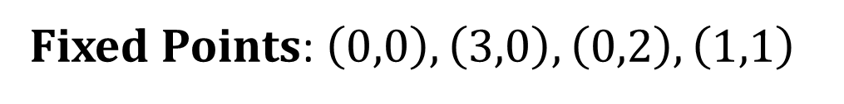
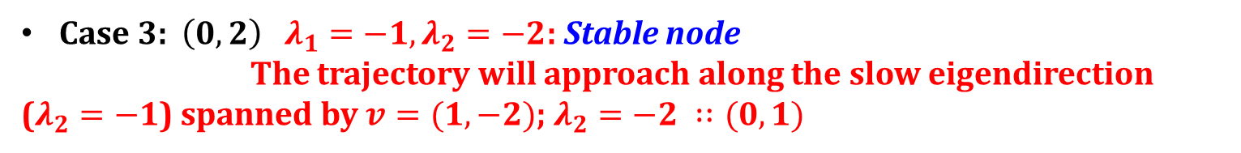
Rabbit Vs Sheep
Fixed Points: $\left(0,0\right), \left(3,0\right), \left(0,2\right), \left(1,1\right)$
Case 1: $\left(0,0\right)$ $λ_{1}=3, λ_{2}=2$ : Unstable node
The trajectory will move away from origin parallel to the eigen vector $v=\left(0,1\right)$ which is assigned for slow eigendirection ($λ_{2}=0$). This vector spans the y axis. The phase portrait near $\left(0,0\right)$ looks like
Case 2: $\left(3,0\right)$ $λ_{1}=−3, λ_{2}=−1$ : Stable node
The trajectory will approach along the slow eigendirection
($λ_{2}=−1$) spanned by $v=(3, −1)$; $λ_{2}=−3 ∷(1,0)$
Case 3: $\left(0,2\right)$ $λ_{1}=−1, λ_{2}=−2$: Stable node
The trajectory will approach along the slow eigendirection ($λ_{2}=−1$) spanned by $v=(1,−2)$; $λ_{2}=−2 ∷(0,1)$
$$\left(\begin{matrix}−1 & 0 \\ −2 & −2\end{matrix}\right)$$

Slide 32
Rabbit Vs Sheep
Fixed Points: $\left(0,0\right), \left(3,0\right), \left(0,2\right), \left(1,1\right)$
Jacobian
Saddle point.

Slide 33
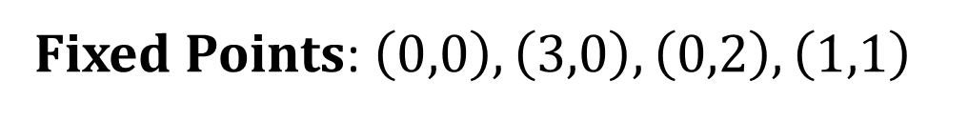
Rabbit Vs Sheep
Fixed Points: $\left(0,0\right), \left(3,0\right), \left(0,2\right), \left(1,1\right)$
Stable Manifold

Slide 34
Rabbit Vs Sheep
Fixed Points: $\left(0,0\right), \left(3,0\right), \left(0,2\right), \left(1,1\right)$
Stable Manifold
One species generally drives other species to extinction
Below stable manifold, the trajectories lead to the sole existence of all rabbits
Above the stable manifold, the trajectories lead to the extinction of rabbits.
Principle of competitive exclusion: Two species competing for same
limited resource cannot coexist!!!!

Slide 35
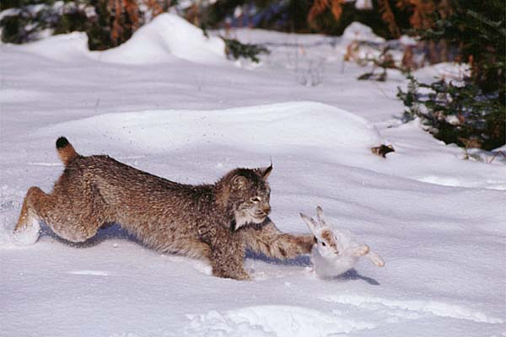
Predator-Prey model: Oscillatory dynamics
Classic example of predator-prey dynamics:
Canadian lynx & snowshoe hare
Coupled oscillation

Slide 36
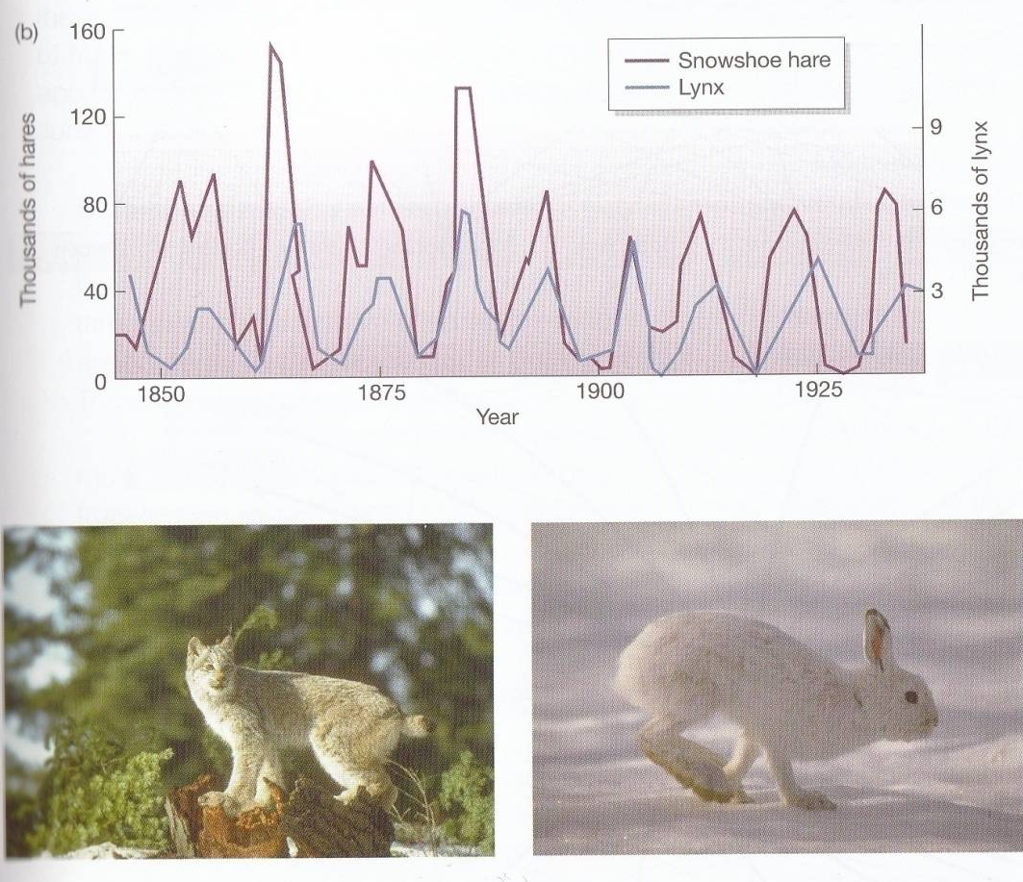
Predator-Prey model: Oscillatory dynamics
prey numbers increase, predator numbers increase…to a point where the predation causes population decline in the prey item..

Slide 37
Predator-Prey model: Oscillatory dynamics

Slide 38
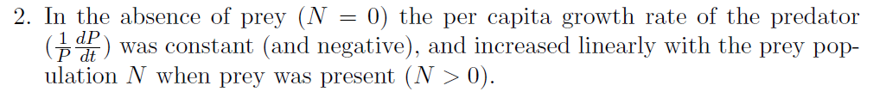
Predator-Prey model: Oscillatory dynamics

Slide 39
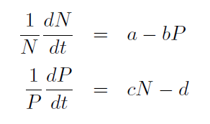
Predator-Prey model: Oscillatory dynamics

Slide 40
Predator-Prey model: Oscillatory dynamics
N | The population of prey at time t
P | The population of predator at time t
a | Rate constant on how fast prey reproduce themselves
b | Rate constant on how fast prey killed by predator
c | Rate constant on how fast predator reproduce when fed from prey
d | Rate constant on how fast predator die

Slide 41

Predator-Prey model: Oscillatory dynamics
Jacobian analysis
Jacobian matrix is formed by the partial derivatives of the ODE functions. In this way, we could approximately decouple the interfering parameters; such linearization allows us to study each parameter independently

Slide 42
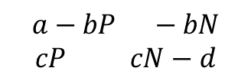
Predator-Prey model: Oscillatory dynamics
Jacobian analysis
Jacobian matrix is formed by the partial derivatives of the ODE functions. In this way, we could approximately decouple the interfering parameters; such linearization allows us to study each parameter independently
$$a−bP −bN$$
$$cP cN−d$$

Slide 43
Jacobian analysis
The sign of the real parts of eigenvalues will determine the behaviours of surrounding points.
A negative value means they will be attracted towards the stationary point, because the change of x or y has an exponential decay.
A positive value means they will be repelled from the stationary point, since the change of x or y has an exponential increase.
A zero value, or eigenvalues appear as conjugate pairs, then they will oscillate around the stationary point, since there is not increase of decrease of x or y.
The magnitude of the eigenvalues will determine the strength of the change.

Slide 44
Jacobian analysis
The sign of the real parts of eigenvalues will determine the behaviours of surrounding points.
A negative value means they will be attracted towards the stationary point, because the change of x or y has an exponential decay.
A positive value means they will be repelled from the stationary point, since the change of x or y has an exponential increase.
A zero value, or eigenvalues appear as conjugate pairs, then they will oscillate around the stationary point, since there is not increase of decrease of x or y.
The magnitude of the eigenvalues will determine the strength of the change.
Hence, the stationary points can be characterized as follow:
If both the real parts of eigenvalues are negative, it is stable.
If one of the real parts of eigenvalues is positive, it is unstable.
If both the real parts of eigenvalues are zero, it is a center.

Slide 45

Jacobian analysis and phase potrait
$$a−bP −bN$$
$$cP cN−d$$

Slide 46
Jacobian analysis and phase potrait
function dydt = model(t,M,a,b,c,d)
n= M(1);
p = M(2);
dn_dt = n*(a-b*p); %%% prey
dp_dt = p*(c*n-d); %% predator
dydt = [dn_dt,dp_dt];
end
$$a−bP −bN$$
$$cP cN−d$$

Slide 47
Jacobian analysis and phase potrait
a = 2/3;
b = 4/3;%0.1;
c =1;% 0.02;
d = 1;
hold on;
x0=1;y0=0.6;
init = [x0 y0]; %% 2/2 1.01/1.01,
t = linspace(0,100,30000)';
% Runge-Kutta 4th-Order Algorithm
y_euler = zeros(length(t), 2);
y_euler(1, :) = init;
h = t(2)-t(1); % Constant time step
for i = 2:length(t)
k1 =model(t(i-1), y_euler(i-1, :),a,b,c,d);
y_euler(i, :) = y_euler(i-1, :)+h*k1;
end
$$a−bP −bN$$
$$cP cN−d$$
function dydt = model(t,M,a,b,c,d)
n= M(1);
p = M(2);
dn_dt = n*(a-b*p); %%% prey
dp_dt = p*(c*n-d); %% predator
dydt = [dn_dt,dp_dt];
end

Slide 48
Nonlinear Dynamics
Bifurcation theory, Fixed points, Limit Cycle and Chaos

Slide 49
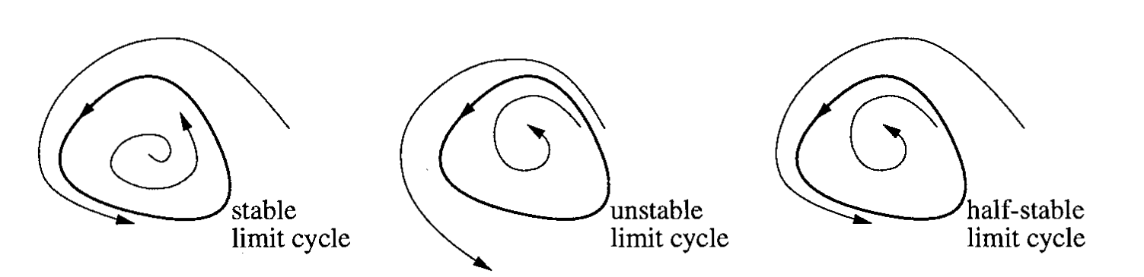
Nonlinear Dynamics
Bifurcation theory, Fixed points, Limit Cycle and Chaos
2-D Flow: Birth of Limit Cycle
Limit Cycle: Isolated Closed Trajectory
”isolated” means that neighbouring trajectories are not closed.
Stable limit cycles play a crucial role in understanding and modeling various natural phenomena. These self-sustained oscillations are prevalent in many biological, chemical, and physical systems.
SSO: systems oscillate even in the absence of any external force (i.e rhythm in body temp., beating of heart, hormone secretion, chemical rxns., neuronal oscillation)

Slide 50
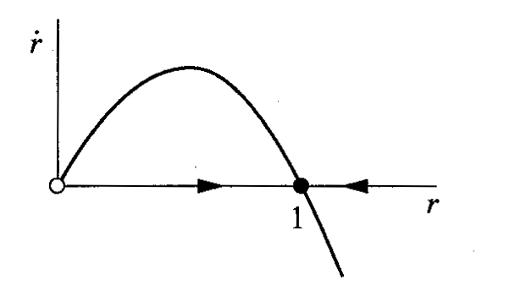
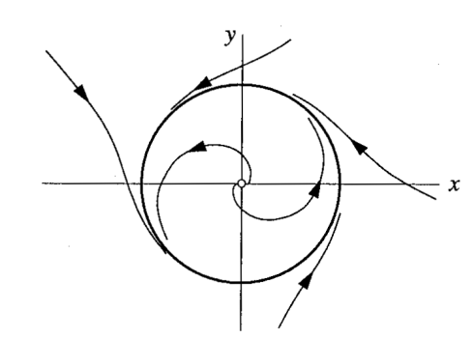
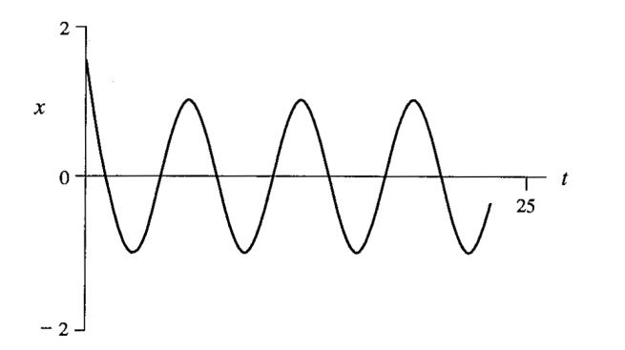

Nonlinear Dynamics
Bifurcation theory, Fixed points, Limit Cycle and Chaos
2-D Flow: Birth of Limit Cycle
Limit Cycle: Isolated Closed Trajectory
Stable
$$\dot{z}=\left(1+iw−{\left|z\right|}^{2}\right)z$$
Unstable

Slide 51



Nonlinear Dynamics
Bifurcation theory, Fixed points, Limit Cycle and Chaos
2-D Flow: Birth of Limit Cycle
Limit Cycle: Isolated Closed Trajectory
$$\dot{z}=\left(1+iw−{\left|z\right|}^{2}\right)z$$
Stable
Unstable
$$z=r\exp{iθ}$$
$$\dot{r}=\left(1−r^{2}\right)r;\dot{θ}=w$$

Slide 52

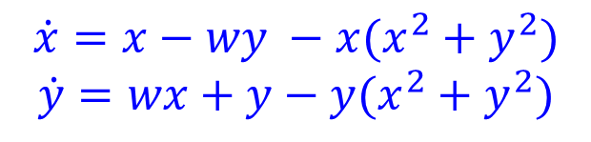

Limit Cycle
$$\dot{z}=\left(1+iw−{\left|z\right|}^{2}\right)z$$
$$\dot{r}=\left(1−r^{2}\right)r;\dot{θ}=w$$
Hence all trajectories in the phase plane (except $r^{∗} = 0$) approach the unit circle $r^{∗}=1$monotonically.
$$\dot{x}=x−wy −x(x^{2}+y^{2})$$
$$\dot{y}=wx+y−y(x^{2}+y^{2})$$

Slide 53

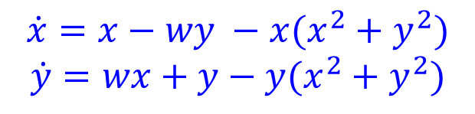




Limit Cycle
$$\dot{z}=\left(1+iw−{\left|z\right|}^{2}\right)z$$
$$\dot{r}=\left(1−r^{2}\right)r;\dot{θ}=w$$
Hence all trajectories in the phase plane (except $r^{∗} = 0$) approach the unit circle $r^{∗}=1$monotonically.
Jacobian
$$\dot{x}=x−wy −x(x^{2}+y^{2})$$
$$\dot{y}=wx+y−y(x^{2}+y^{2})$$
$$1−3x^{2}−y^{2}$$
$$−w −2yx$$
$$w −2yx$$
$$1−3y^{2}−x^{2}$$
$$(0,0)$$

Slide 54

Limit Cycle
$$\dot{z}=\left(1+iw−{\left|z\right|}^{2}\right)z$$
$$\dot{r}=\left(1−r^{2}\right)r;\dot{θ}=w$$
Hence all trajectories in the phase plane (except $r^{∗} = 0$) approach the unit circle $r^{∗}=1$monotonically.
Jacobian
$$\dot{x}=x−wy −x(x^{2}+y^{2})$$
$$\dot{y}=wx+y−y(x^{2}+y^{2})$$
$$1−3x^{2}−y^{2}$$
$$−w −2yx$$
$$λ_{1,2}=1±iw$$
$$w −2yx$$
$$1−3y^{2}−x^{2}$$
$$(0,0)$$
Origin is an unstable spiral point for both the linear system and the nonlinear system.
Therefore, any solution that starts near the origin in the phase plane will spiral away from the origin.

Slide 55

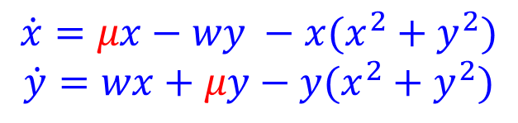


Limit Cycle
$$\dot{z}=\left(μ+iw−{\left|z\right|}^{2}\right)z$$
$$\dot{r}=\left(μ−r^{2}\right)r;\dot{θ}=w$$
$$\dot{x}=μx−wy −x(x^{2}+y^{2})$$
$$\dot{y}=wx+μy−y(x^{2}+y^{2})$$
$$μ$$
$$μ<0$$
$$μ=0$$
$$μ>0$$

Slide 56
Limit Cycle: VanderPol Oscillator
$${\ddot{x}}_{}+μ(x^{2}−1) \dot{x} +x = 0$$

Slide 57
Limit Cycle
A limit cycle refers to a repeating pattern of behavior in a dynamic system. While it is true that limit cycles are not necessarily circular, they may exhibit complex and irregular shapes. The statement that limit cycles are not generally circles and often need to be found numerically is accurate.
In many real-world systems, especially nonlinear systems, the behavior might not be described by simple sinusoidal functions. The trajectories of the system might follow more intricate paths, and determining the shape of the limit cycle may require numerical methods and simulations rather than analytical solutions.
If a trajectory is confined to a closed, bounded region that contains no fixed points, then the trajectory eventually must approach a closed orbit.

Slide 58
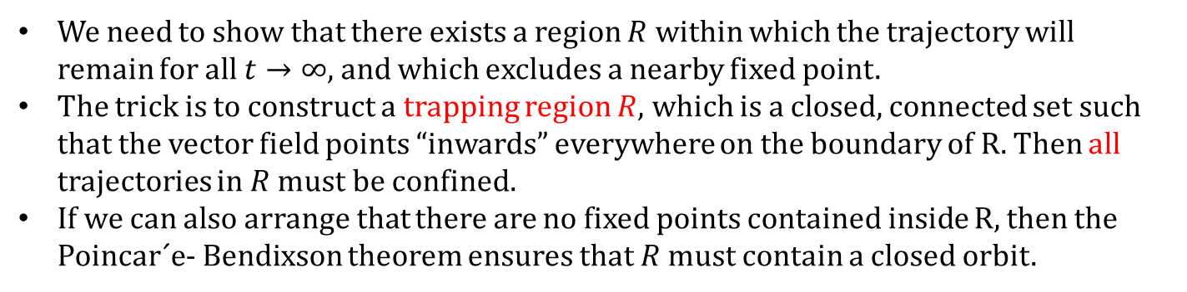
Limit Cycle
The Poincar´e-Bendixson Theorem
If a trajectory is confined to a closed, bounded region that contains no fixed points, then the trajectory eventually must approach a closed orbit.
To determine if a trajectory is confined to a closed, bounded region
We need to show that there exists a region $R$ within which the trajectory will remain for all $t→∞$, and which excludes a nearby fixed point.
The trick is to construct a trapping region $R$, which is a closed, connected set such that the vector field points “inwards” everywhere on the boundary of R. Then all trajectories in $R$ must be confined.
If we can also arrange that there are no fixed points contained inside R, then the Poincar´e- Bendixson theorem ensures that $R$ must contain a closed orbit.

Slide 59
Limit Cycle
The Poincar´e-Bendixson Theorem
If a trajectory is confined to a closed, bounded region that contains no fixed points, then the trajectory eventually must approach a closed orbit.
To determine if a trajectory is confined to a closed, bounded region
We need to show that there exists a region $R$ within which the trajectory will remain for all $t→∞$, and which excludes a nearby fixed point.
The trick is to construct a trapping region $R$, which is a closed, connected set such that the vector field points “inwards” everywhere on the boundary of R. Then all trajectories in $R$ must be confined.
If we can also arrange that there are no fixed points contained inside R, then the Poincar´e- Bendixson theorem ensures that $R$ must contain a closed orbit.

Slide 60
Networks and Dynamics
Synchrony in limit cycles: Kuramoto oscillators
Stability of large predator-prey systems

Slide 61
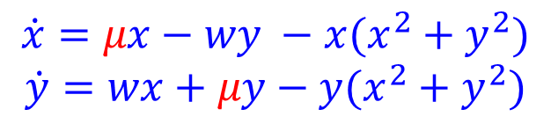
Network of Limit Cycle: active and inactive oscillators
$$\dot{z}=\left(μ+iw−{\left|z\right|}^{2}\right)z$$
$$\dot{x}=μx−wy −x(x^{2}+y^{2})$$
$$\dot{y}=wx+μy−y(x^{2}+y^{2})$$
$$\dot{r}=\left(μ−r^{2}\right)r;\dot{θ}=w$$

Slide 62
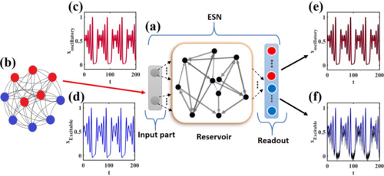

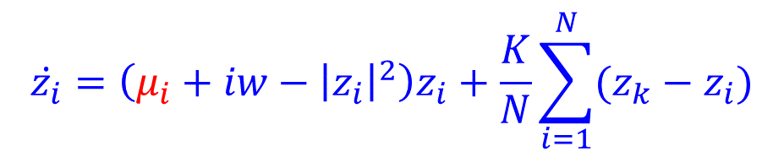


Network of Limit Cycle: active and inactive oscillators
$$\dot{z}=\left(μ+iw−{\left|z\right|}^{2}\right)z$$
$$\dot{x}=μx−wy −x(x^{2}+y^{2})$$
$$\dot{y}=wx+μy−y(x^{2}+y^{2})$$
$$\dot{r}=\left(μ−r^{2}\right)r;\dot{θ}=w$$
$$\dot{z_{i}}=\left(μ_{i}+iw−{\left|z_{i}\right|}^{2}\right)z_{i}+\frac{K}{N}\sum_{i=1}^{N}{(z_{k}−z_{i})}$$
$$0<p<1$$
$$l=1,…p×N :μ<0$$
$$l=\left(p×N\right)+1,…N μ>0$$

Slide 63
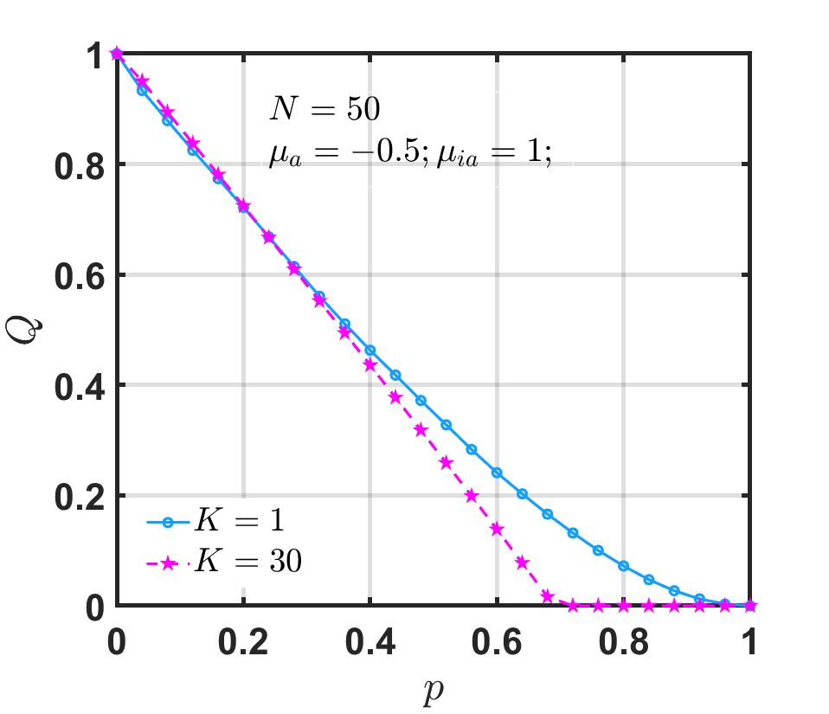

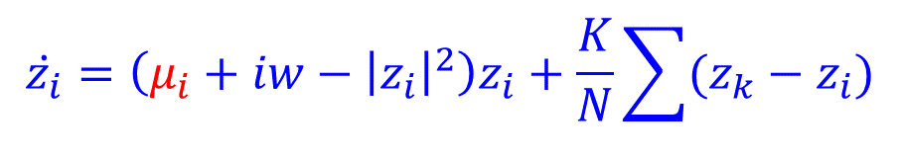



Network of Limit Cycle: active and inactive oscillators
$$\dot{z_{i}}=\left(μ_{i}+iw−{\left|z_{i}\right|}^{2}\right)z_{i}+\frac{K}{N}\sum{(z_{k}−z_{i})}$$
$$i=1,…N$$
$$0<p<1$$
$$l=1,…p×N :μ<0$$
$$l=\left(p×N\right)+1,…N μ>0$$

Slide 64
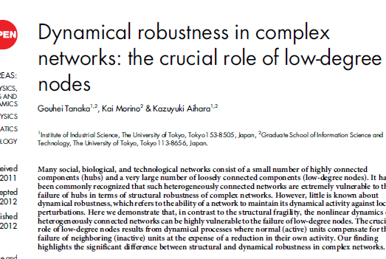
Network of Limit Cycle: active and inactive oscillators

Slide 65

Network of Limit Cycle: active and inactive oscillators

